Slide 1
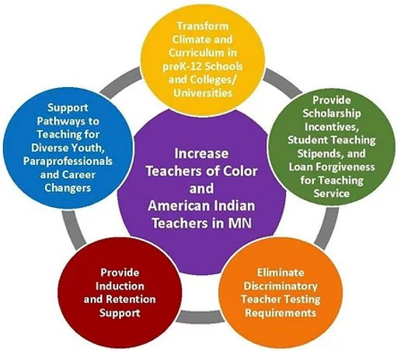
What is ITCA 2022?
About ITCA: The 2022 Increase Teachers of Color Act (ITCA) is a comprehensive package of bills crafted to address the systemic barriers to increasing the percentage of TOCAIT in districts throughout Minnesota
According to state statute passed in 2016, all students should have “equitable access to effective and diverse teachers” who reflect “the diversity of students in their schools”
See: www.tocaimn.com/legislation

Slide 2
Youth Social Media Influencer Contest
About the contest: The Coalition to Increase Teachers of Color and American Indian Teachers in Minnesota will offer up to 26 “scholarship awards” to BIPOC or white youth who create the most engaging and influential efforts encouraging civic participation on social media and beyond to persuade lawmakers to pass the Increase Teachers of Color Act.
Awards:
Top Influencer - $1,000
Next 10 Influencers - $750
Next 15 Influencers - $500
Goals: 1. Get more people involved to pass ITCA 2. Raise awareness about ITCA
Learn More: https://www.tocaimn.com/itca-social-media-competition

Slide 3
How to participate?
Sign up! https://forms.gle/XfJqEUU4Qr1U28xNA
Learn more about the cause at https://www.tocaimn.com/legislation
See actions and point values along with other contest guidelines https://www.tocaimn.com/competition-guidelines
Take action, log your actions, and start racking up points now through March 25!

Slide 4
FAQ’s
What do some posts look like?
https://fb.watch/aKydh3jzZL/
How old do you have to be to participate?
Must be in grades 6-12!
What if I don’t have social media?
That’s okay! In-person contact can also be documented and can do incredible things
When are winners notified?
Winners will be announced by mid April
What if I have more questions?
Email info@tocaimn.com with subject line: Contest Question

